Slide 1
Leveraging the Microsoft Graph API from the SharePoint Framework
Understanding how SharePoint Framework accesses the Microsoft Graph

Slide 2

Microsoft Graph REST API
Understanding how the SharePoint Framework and calls the Microsoft Graph
Granting SharePoint Online Tenants scopes to access Microsoft Graph Resources
Resources

Slide 3
Office 365 and SharePoint Online Users Already Authenticated
Users in Office 365 are already authenticated
SharePoint Online & Office 365 share the same Azure AD dependency as Microsoft Graph
Users login to Office 365 with their Work & School account (Azure AD)
Calls to the Microsoft Graph are proxied through SharePoint Online
Eliminates the need for creation of a separate Azure AD application
Does not bypass any permission / scope requirements
Can only access business entities, not consumer entities
Notes:
Let’s review from the previous section

Slide 4
Calling Secured Services from Client-side Code is a Challenge
Calling a secured service, like Microsoft Graph, requires the acquisition of a token
Authenticate and get authorized with Azure AD using an Azure AD application
Interactive login & programmatic acquisition of access token
Client-side applications cannot securely do this across domains seamlessly
Can’t store application ID’s and secrets client side as they cannot be protected
Require an authentication prompt with a popup or redirection

Slide 5
Solution: Proxy Calls to Secured Services through Existing Application
SharePoint Online already has an Azure AD application
Client-side solutions in SharePoint Online call the SharePoint REST API in the same domain
No extra authentication required
Provided these tenants have granted the necessary scopes, SharePoint will call the Microsoft Graph
Responses from the Microsoft Graph are returned back to the client-side application
Permission requests to Azure AD applications (aka: resources) must be approved
Only SharePoint Online tenant administrators can grant / reject permission requests
Approved permissions are available to all client-side solutions in a tenant

Slide 6
Granting Scopes to Azure AD Protected Resources in SharePoint Online

Slide 7
SPFx Solutions Declare Permission Requests
// package-solution.json
{
"$schema": "https://developer.microsoft.com/json-schemas/spfx-build/package-solution.schema.json",
"solution": {
"name": "ms-graph-sp-fx-client-side-solution",
"id": "dfb230b7-4f61-431f-9b65-a34e83922663",
"version": "1.0.0.0",
"includeClientSideAssets": true,
"webApiPermissionRequests": [
{ "resource": "Microsoft Graph", "scope": "User.ReadBasic.All” },
{ "resource": "Microsoft Graph", "scope": "Calendars.Read” },
{ "resource": "Microsoft Graph", "scope": "Tasks.Read” }
]
},
"paths": {
"zippedPackage": "solution/ms-graph-sp-fx.sppkg"
}
}

Slide 8
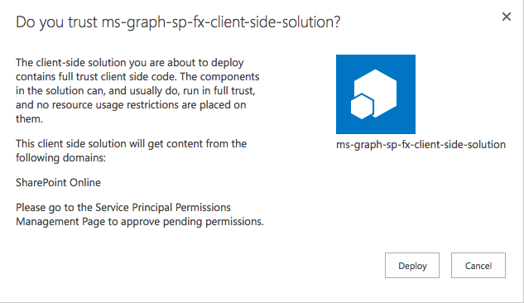
Add SharePoint Package to SharePoint App Catalog
Upload SharePoint packages to the app catalog
Extra note in dialog notifies of additional step required
While application can be installed in SharePoint sites, it does not have the permissions granted that it needs to access Azure AD protected resources

Slide 9
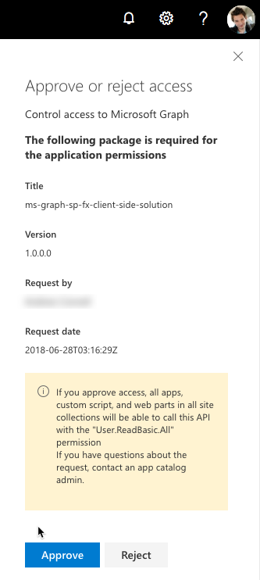
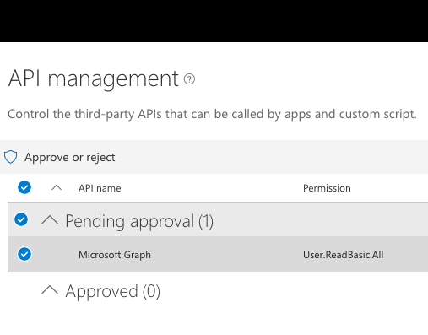
Approve / Reject with SharePoint Online API Management Page

Slide 10
Demo Accessing User Calendar Events from the Microsoft Graph in a SharePoint Framework Client-Side Web Part

Slide 11

Summary
Users of Office 365 and SharePoint Online are already authenticated with their Azure AD work or school account
Tenant administrators grant Microsoft Graph scopes to SharePoint Online tenants
All client–side calls from that tenant proxy requests to the Microsoft Graph via the SharePoint Azure AD application

Slide 12
Reading further
SharePoint Framework Documentation
https://docs.microsoft.com/sharepoint/dev/spfx/sharepoint-framework-overview
Use the MSGraphClient to Connect to Microsoft Graph
https://docs.microsoft.com/sharepoint/dev/spfx/use-msgraph
Consume Microsoft Graph (tutorial)
https://docs.microsoft.com/sharepoint/dev/spfx/use-aad-tutorial

Slide 13
Thank you.

